Slide 1
2025 | JAN 1 - JUNE 30
MT. ZION BAPTIST CHURCH
FINANCIAL REPORT

Slide 2
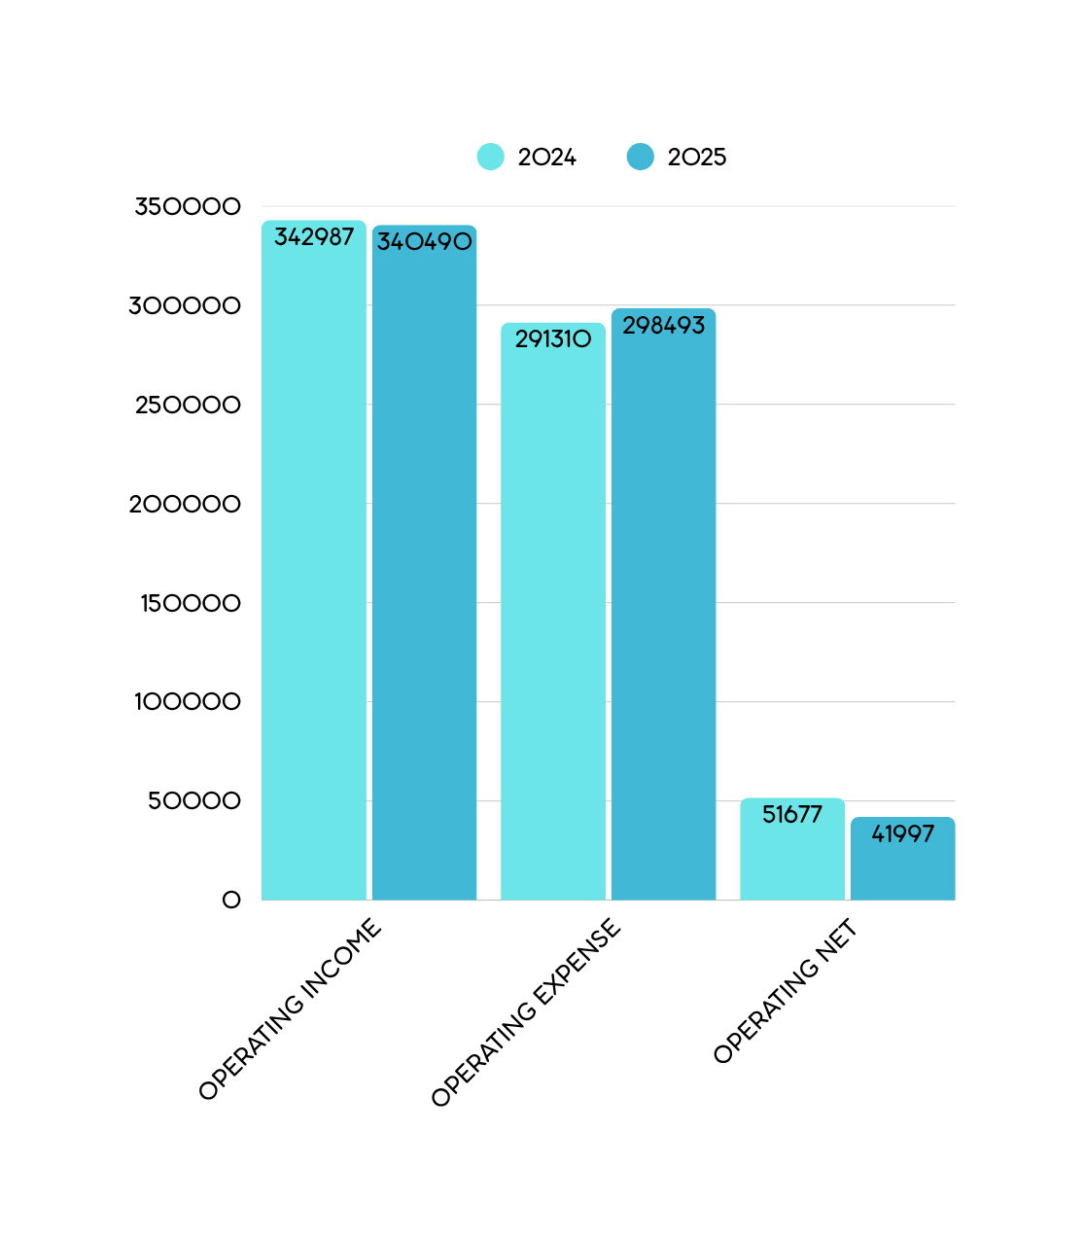
Our Operating Income for the period January 1, 2025, to June 30, 2025, was $340,489.61
and our Operating Expenses were $298,492.56. This gave us an Operating Net Income
of $41,997.05. This compared to an Operating Income of $342,987.46, Operating
Expenses of $291,310.12 and an Operating Net Income of $51,677.34 for the prior year
comparison.
THE ABOVE FIGURES WERE WITHOUT DEPRECIATION.

Slide 3
We are currently at 87.79% of our Operating Budget Income (Red Indicator) and at
92.83% (Green Indicator) of our Operating Budget Expenses.
OPERATING BUDGET INCOME
OPERATING BUDGET EXPENSES
87.79%
92.83%

Slide 4
OUR MORTGAGE RETIREMENT INCOME FOR THE PERIOD JANUARY 1, 2025, TO JUNE 30, 2025, WAS
$650.00.

Slide 5
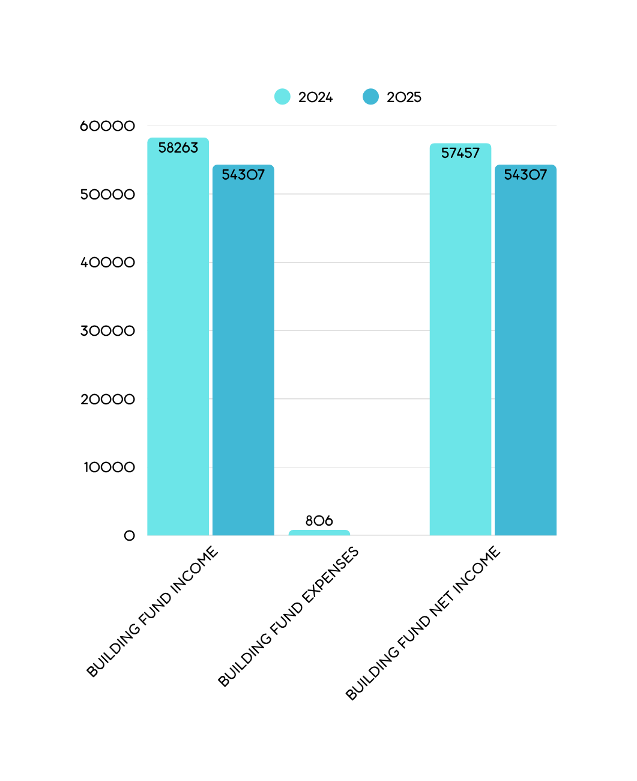
Our Building Fund Income for the period January 1, 2025, to June 30, 2025, was $54,307.31 and our Building Fund Expenses were $0.00. This gave us a Building Fund Net Income of $54,307.31. This compared to a Building Fund Income of $58,263.08, Building Fund Expenses of $806.00, and a Building Fund Net Income of $57,457.08 for the prior year comparison.

Slide 6
GRANT INCOME
Our Grant Income for the period January 1, 2025, to June 30, 2025, was $42,698.02 and
our Grant Expenses were $24,012.24.
BUILDING FUND BALANCE
The current Building Fund Balance is $1,269,002.03.
(Accounts 1050, 1055, 1105, 1400, 1125, 1130, 1135, 1140, & 1145)

